Slide 1
Chapter 7 More SQL: Complex Queries

Slide 2
- More Complex SQL Retrieval Queries - Views (Virtual Tables) in SQL - Schema Change Statements in SQL
Content

Slide 3
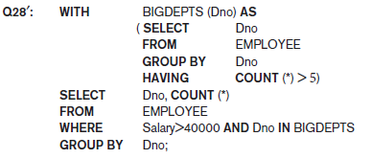
More Complex SQL Retrieval Queries
Other SQL Constructs: WITH and CASE
The WITH clause allows a user to define a table that will only be used in a subsequent query.
In Q28′, we defined in the WITH clause a temporary table BIG_DEPTS whose result holds the Dno’s of departments with more than five employees, then used this table in the subsequent query.
Once this query is executed, the temporary table BIGDEPTS is discarded.

Slide 4
More Complex SQL Retrieval Queries
Other SQL Constructs: WITH and CASE
It is considered “temporary” because the result is not permanently stored anywhere in the database schema.
It acts as a temporary view that only exists for the duration of the query.
The key advantage of the WITH clause is that it helps organize and simplify long and complex hierarchical queries by breaking them down into smaller, more readable chunks.

Slide 5
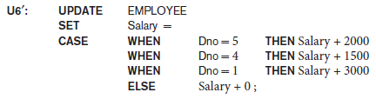
More Complex SQL Retrieval Queries
Other SQL Constructs: WITH and CASE
CASE construct can be used when a value can be different based on certain conditions.
This can be used in any part of an SQL query where a value is expected, including when querying, inserting or updating tuples.
Suppose we want to give employees different raise amounts depending on which department they work for; for example, employees in department 5 get a $2,000 raise, those in department 4 get $1,500 and those in department 1 get $3,000.
The CASE construct can also be used when inserting tuples.

Slide 6
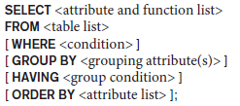
More Complex SQL Retrieval Queries
Discussion and Summary of SQL Queries
A retrieval query in SQL can consist of up to six clauses, but only the first two— SELECT and FROM—are mandatory.
The query can span several lines and is ended by a semicolon.
Query terms are separated by spaces, and parentheses can be used to group relevant parts of a query in the standard way.
The clauses are specified in the following order, with the clauses between square brackets [ … ] being optional.

Slide 7
More Complex SQL Retrieval Queries
Discussion and Summary of SQL Queries
The SELECT clause lists the attributes or functions to be retrieved.
The FROM clause specifies all relations (tables) needed in the query, including joined relations.
The WHERE clause specifies the conditions for selecting the tuples from these relations, including join conditions if needed.
GROUP BY specifies grouping attributes, whereas HAVING specifies a condition on the groups being selected rather than on the individual tuples.
The built-in aggregate functions COUNT, SUM, MIN, MAX, and AVG are used in conjunction with grouping, but they can also be applied to all the selected tuples in a query without a GROUP BY clause.
Finally, ORDER BY specifies an order for displaying the result of a query.

Slide 8
More Complex SQL Retrieval Queries
Discussion and Summary of SQL Queries
A query is evaluated conceptually by first applying the FROM clause (to identify all tables involved in the query or to materialize any joined tables), followed by the WHERE clause to select and join tuples, and then by GROUP BY and HAVING.
Conceptually, ORDER BY is applied at the end to sort the query result.
If none of the last three clauses (GROUP BY, HAVING, and ORDER BY) are specified, we can think conceptually of a query as being executed as follows:
For each combination of tuples—one from each of the relations specified in the FROM clause—evaluate the WHERE clause; if it evaluates to TRUE, place the values of the attributes specified in the SELECT clause from this tuple combination in the result of the query.

Slide 9
Schema Change Statements in SQL
The DROP Command
The DROP command can be used to drop named schema elements, such as tables, domains, or constraints.
One can also drop a whole schema if it is no longer needed by using the DROP SCHEMA command.
There are two drop behavior options: CASCADE and RESTRICT.
For example, to remove the COMPANY database schema and all its tables, domains, and other elements, the CASCADE option is used as follows:
DROP SCHEMA COMPANY CASCADE;
If the RESTRICT option is chosen in place of CASCADE, the schema is dropped only if it has no elements in it; otherwise, the DROP command will not be executed.
To use the RESTRICT option, the user must first individually drop each element in the schema, then drop the schema itself.

Slide 10
Schema Change Statements in SQL
The DROP Command
If a base relation within a schema is no longer needed, the relation and its definition can be deleted by using the DROP TABLE command.
For example, if we no longer wish to keep track of dependents of employees in the COMPANY database, we can get rid of the DEPENDENT relation by issuing the following command:
DROP TABLE DEPENDENT CASCADE;
With the CASCADE option, all such constraints, views, and other elements that reference the table being dropped are also dropped automatically from the schema, along with the table itself. (drop all referential integrity constraints that refer to primary keys).
If the RESTRICT option is chosen instead of CASCADE, a table is dropped only if it is not referenced in any constraints (for example, by foreign key definitions in another relation) or views or by any other elements.

Slide 11
Schema Change Statements in SQL
The DROP Command
Notice that the DROP TABLE command not only deletes all the records in the table if successful, but also removes the table definition from the catalog.
If it is desired to delete only the records but to leave the table definition for future use, then the DELETE command should be used instead of DROP TABLE.
The DROP command can also be used to drop other types of named schema elements, such as constraints or domains.

Slide 12
Schema Change Statements in SQL
The ALTER Command
The definition of a base table or of other named schema elements can be changed by using the ALTER command.
For base tables, the possible alter table actions include
adding or dropping a column (attribute),
changing a column definition,
and adding or dropping table constraints.

Slide 13
Schema Change Statements in SQL
The ALTER Command
For example, to add an attribute for keeping track of jobs of employees to the EMPLOYEE base relation in the COMPANY schema we can use the command
We must still enter a value for the new attribute Job for each individual EMPLOYEE tuple.
This can be done either by specifying a default clause or by using the UPDATE command individually on each tuple.
If no default clause is specified, the new attribute will have NULLs in all the tuples of the relation immediately after the command is executed; hence, the NOT NULL constraint is not allowed in this case.

Slide 14

Schema Change Statements in SQL
The ALTER Command
To drop a column, we must choose either CASCADE or RESTRICT for drop behavior.
If CASCADE is chosen, all constraints and views that reference the column are dropped automatically from the schema, along with the column.
If RESTRICT is chosen, the command is successful only if no views or constraints (or other schema elements) reference the column.
For example, the following command removes the attribute Address from the EMPLOYEE base table:
It is also possible to alter a column definition by dropping an existing default clause or by defining a new default clause. The following examples illustrate this clause:

Slide 15

Schema Change Statements in SQL
The ALTER Command
One can also change the constraints specified on a table by adding or dropping a named constraint.
To be dropped, a constraint must have been given a name when it was specified.
For example, to drop the constraint named EMPSUPERFK in Figure 6.2 from the EMPLOYEE relation, we write:
Once this is done, we can redefine a replacement constraint by adding a new constraint to the relation, if needed.
This is specified by using the ADD CONSTRAINT keyword in the ALTER TABLE statement followed by the new constraint, which can be named or unnamed and can be of any of the table constraint types discussed.

Slide 16
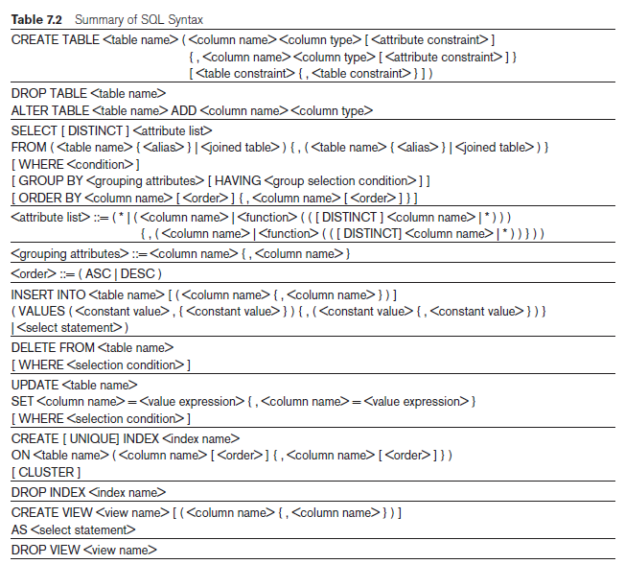
Summary of SQL

Slide 17
Views (Virtual Tables) in SQL
Concept of a View in SQL
A view is a single table that is derived from other tables.
A view does not necessarily exist in physical form; it is considered to be a virtual table, in contrast to base tables, whose tuples are always physically stored in the database.
We can think of a view as a way of specifying a table that we need to reference frequently, even though it may not exist physically.
You can select data from multiple tables, or you can select specific data based on certain criteria in views.
It holds only the definition of the view in the data dictionary.

Slide 18
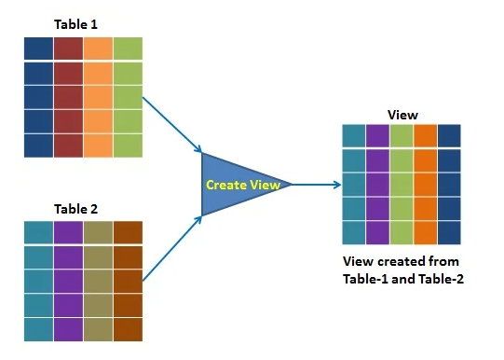
Views (Virtual Tables) in SQL
Concept of a View in SQL
The view is a query stored in the data dictionary, on which the user can query just like they do on tables.
It does not use the physical memory, only the query is stored in the data dictionary.
It is computed dynamically, whenever the user performs any query on it.
Changes made at any point in view are reflected in the actual base table.

Slide 19
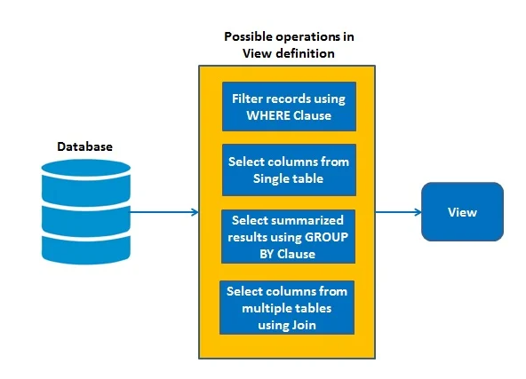
Views (Virtual Tables) in SQL
Concept of a View in SQL
The view has primarily two purposes:
Simplify the complex SQL queries.
Provide restriction to users from accessing sensitive data.

Slide 20
Views (Virtual Tables) in SQL
Concept of a View in SQL
For example, referring to the COMPANY database, we may frequently issue queries that retrieve the employee name and the project names that the employee works on.
Rather than having to specify the join of the three tables EMPLOYEE, WORKS_ON, and PROJECT every time we issue this query, we can define a view that is specified as the result of these joins.
Then we can issue queries on the view, which are specified as single table retrievals rather than as retrievals involving two joins on three tables. We call the EMPLOYEE, WORKS_ON, and PROJECT tables the defining tables of the view.

Slide 21
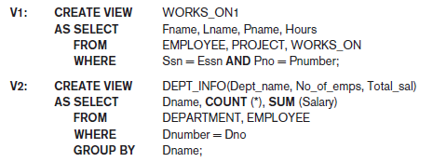
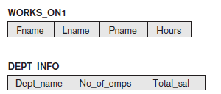
Views (Virtual Tables) in SQL
Specification of Views in SQL
In SQL, the command to specify a view is CREATE VIEW.
The view is given a (virtual) table name (or view name), a list of attribute names, and a query to specify the contents of the view.
If none of the view attributes results from applying functions or arithmetic operations, we do not have to specify new attribute names for the view, since they would be the same as the names of the attributes of the defining tables in the default case.

Slide 22

Views (Virtual Tables) in SQL
Specification of Views in SQL
In V1, we did not specify any new attribute names for the view WORKS_ON1 (although we could have); in this case, WORKS_ON1 inherits the names of the view attributes from the defining tables EMPLOYEE, PROJECT, and WORKS_ON.
View V2 explicitly specifies new attribute names for the view DEPT_INFO, using a one-to-one correspondence between the attributes specified in the CREATE VIEW clause and those specified in the SELECT clause of the query that defines the view.
For example, to retrieve the last name and first name of all employees who work on the ‘ProductX’ project, we can utilize the WORKS_ON1 view and specify the query as in QV1:

Slide 23

Views (Virtual Tables) in SQL
Specification of Views in SQL
The same query would require the specification of two joins if specified on the base relations directly; one of the main advantages of a view is to simplify the specification of certain queries.
A view is supposed to be always up-to-date; if we modify the tuples in the base tables on which the view is defined, the view must automatically reflect these changes.
Hence, the view does not have to be realized or materialized at the time of view definition but rather at the time when we specify a query on the view.
If we do not need a view anymore, we can use the DROP VIEW command to dispose of it.
For example, to get rid of the view V1, we can use the SQL statement in V1A:

Slide 24
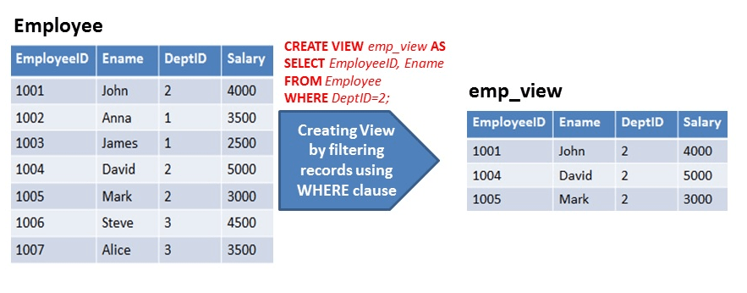
Views (Virtual Tables) in SQL
Types of Views
Simple View: A view based on only a single table, which doesn't contain GROUP BY clause and any functions.

Slide 25
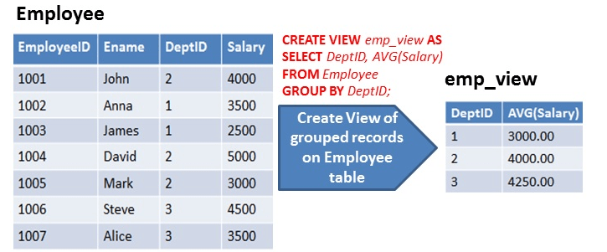
Views (Virtual Tables) in SQL
Types of Views
Complex View: A view based on multiple tables, which contain GROUP BY clause and functions.

Slide 26
Views (Virtual Tables) in SQL
Types of Views
Materialized View
Materialized view replicates the retrieved data physically. This replicated data can be reused without executing the view again.
This type of view is also known as "SNAPSHOTS".
Materialized view reduce the processing time to regenerate the whole data.
The challenging part here is to synchronize the changes in materialized views underlying tables.

Slide 27
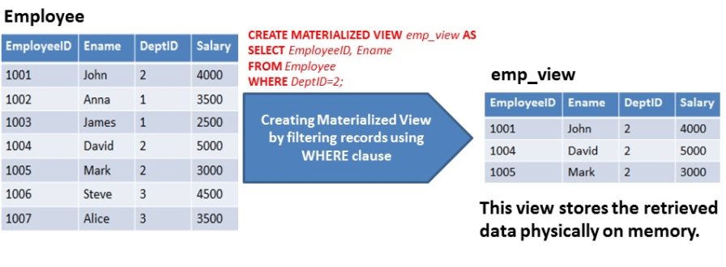
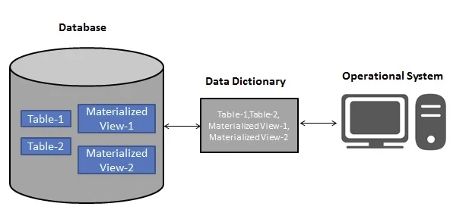
Views (Virtual Tables) in SQL
Types of Views
Materialized View

Slide 28
Views (Virtual Tables) in SQL
View Implementation, View Update, and Inline Views
The problem of how a DBMS can efficiently implement a view for efficient querying is complex.
One strategy, called query modification, involves modifying or transforming the view query (submitted by the user) into a query on the underlying base tables.
Disadvantage of this approach: it is inefficient for views defined via complex queries that are time-consuming to execute, especially if multiple view queries are going to be applied to the same view within a short period of time.

Slide 29


Views (Virtual Tables) in SQL
View Implementation, View Update, and Inline Views
For example, the query QV1 would be automatically modified to the following query by the DBMS:

Slide 30
Views (Virtual Tables) in SQL
View Implementation, View Update, and Inline Views
The second strategy, called view materialization, involves physically creating a temporary or permanent view table when the view is first queried or created and keeping that table on the assumption that other queries on the view will follow.
In this case, an efficient strategy for automatically updating the view table when the base tables are updated must be developed in order to keep the view up-to-date.
Techniques using the concept of incremental update have been developed for this purpose, where the DBMS can determine what new tuples must be inserted, deleted, or modified in a materialized view table when a database update is applied to one of the defining base tables.

Slide 31
Views (Virtual Tables) in SQL
View Implementation, View Update, and Inline Views
The view is generally kept as a materialized (physically stored) table as long as it is being queried.
If the view is not queried for a certain period of time, the system may then automatically remove the physical table and recompute it from scratch when future queries reference the view.
Strategies as to when a materialized view is updated are:
1. Immediate update strategy: updates a view as soon as the base tables are changed.
2. Lazy update strategy: updates the view when needed by a view query.
3. Periodic update strategy: updates the view periodically (in the latter strategy, a view query may get a result that is not up-to-date).

Slide 32
Views (Virtual Tables) in SQL
View Implementation, View Update, and Inline Views
A user can always issue a retrieval query against any view.
However, issuing an INSERT, DELETE, or UPDATE command on a view table is in many cases not possible.
An update on a view defined on a single table without any aggregate functions can be mapped to an update on the underlying base table under certain conditions.
For a view involving joins, an update operation may be mapped to update operations on the underlying base relations in multiple ways.
Hence, it is often not possible for the DBMS to determine which of the updates is intended.

Slide 33

Views (Virtual Tables) in SQL
View Implementation, View Update, and Inline Views
To illustrate potential problems with updating a view defined on multiple tables, consider the WORKS_ON1 view, and suppose that we issue the command to update the PNAME attribute of ‘John Smith’ from ‘ProductX’ to ‘ProductY’.
This view update is shown in UV1:
This query can be mapped into several updates on the base relations to give the desired update effect on the view.

Slide 34
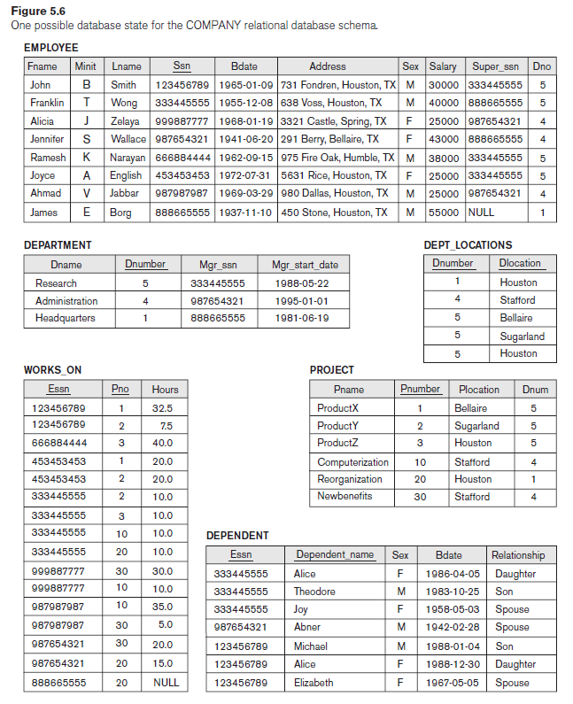
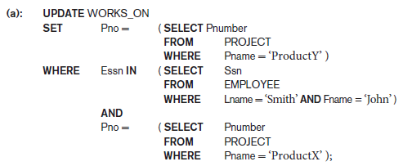
Views (Virtual Tables) in SQL
View Implementation, View Update, and Inline Views
Update (a) relates ‘John Smith’ to the ‘ProductY’ PROJECT tuple instead of the ‘ProductX’ PROJECT tuple and is the most likely desired update.

Slide 35

Views (Virtual Tables) in SQL
View Implementation, View Update, and Inline Views
However, (b) would also give the desired update effect on the view, but it accomplishes this by changing the name of the ‘ProductX’ tuple in the PROJECT relation to ‘ProductY’.
It is quite unlikely that the user who specified the view update UV1 wants the update to be interpreted as in (b), since it also has the side effect of changing all the view tuples with Pname = ‘ProductX’.

Slide 36

Views (Virtual Tables) in SQL
View Implementation, View Update, and Inline Views
Some view updates may not make much sense; for example, modifying the Total_sal attribute of the DEPT_INFO view does not make sense because Total_sal is defined to be the sum of the individual employee salaries.
This incorrect request is shown as UV2:
Generally, a view update is feasible when only one possible update on the base relations can accomplish the desired update operation on the view.
Whenever an update on the view can be mapped to more than one update on the underlying base relations, it is usually not permitted.

Slide 37
Views (Virtual Tables) in SQL
View Implementation, View Update, and Inline Views
When can views not be updated?
In summary, we can make the following observations:
A view with a single defining table is updatable if the view attributes contain the primary key of the base relation, as well as all attributes with the NOT NULL constraint that do not have default values specified.
Views defined on multiple tables using joins are generally not updatable.
Views defined using grouping and aggregate functions are not updatable.
The view must not have any DISTINCT clause in its definition.

Slide 38

Views (Virtual Tables) in SQL
View Implementation, View Update, and Inline Views
In SQL, the clause WITH CHECK OPTION should be added at the end of the view definition if a view is to be updated by INSERT, DELETE, or UPDATE statements.
This allows the system to reject operations that violate the SQL rules for view updates.
It is also possible to define a view table in the FROM clause of an SQL query. This is known as an in-line view. In this case, the view is defined within the query itself.

Slide 39

Views (Virtual Tables) in SQL
Views as Authorization Mechanisms
Suppose a certain user is only allowed to see employee information for employees who work for department 5.
We can create the following view DEPT5EMP and grant the user the privilege to query the view but not the base table EMPLOYEE itself.
This user will only be able to retrieve employee information for employee tuples whose Dno = 5 and will not be able to see other employee tuples when the view is queried.

Slide 40

Views (Virtual Tables) in SQL
Views as Authorization Mechanisms
In a similar manner, a view can restrict a user to only see certain columns; for example, only the first name, last name, and address of an employee may be visible as follows:
Thus by creating an appropriate view and granting certain users access to the view and not the base tables, they would be restricted to retrieving only the data specified in the view.

Slide 41
Views (Virtual Tables) in SQL
Pros and Cons of Views
Pros
It helps us to provide an abstraction to various users or hide the complexity for users who are accessing data from the table.
It can help us to simplify complex queries into a simpler one.
Views can be used for security purposes or can add extra value from the security point of view.
It does not hold any space because it only has the definition in the data dictionary, not the copy of actual data.

Slide 42
Views (Virtual Tables) in SQL
Pros and Cons of Views
Cons
Besides the lots of advantages, views also have some disadvantages such as computation time, and restrictions.
Views have a dependency on the table structure.

